Slide 1

PYTHON-1I INDIVIUAL PROJECT:- CHAT APPLICATION
Made by:-Priyansh Dahake
Roll no:-50
Batch:-A2
Branch:-CE

Slide 2

INTRODUCTION
Chatting app allows you to communicate with your customers in chat rooms. It also allows allow you to stay connected with other people who may be using the application even on the other side of the world.
It enables you to send and receive messages. Chatting apps make it easier, simpler, and faster to connect with everyone and it is also easy to use.
Some examples of chat application are whatsapp, twitter, facebook etc.

Slide 3
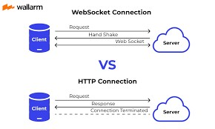
WEBSOCKET
Web Socket is bidirectional protocol that is used in the same scenario of client-server communication,.
It starts from ws:// or wss://. It is a stateful protocol, which means the connection between client and server will keep alive until it is terminated by either party (client or server).

Slide 4
CHANNELS
Channels preserve the synchronous behavior of django and add a layer of asynchronous protocols allowing users to write the views that are entirely synchronous, asynchronous, or a mixture of both. Channels basically allow the application to support “long-running connections”.
It replaces Django’s default wsgi with its asgi.
ASGI (Asynchronous Server Gateway Interface) provides an interface between async Python web servers and applications while it supports all the features provided by WSGI.

Slide 5
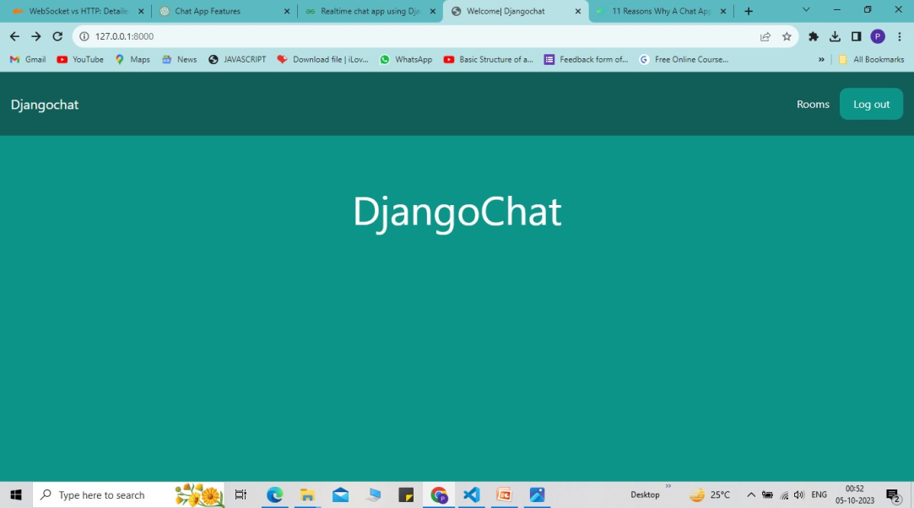
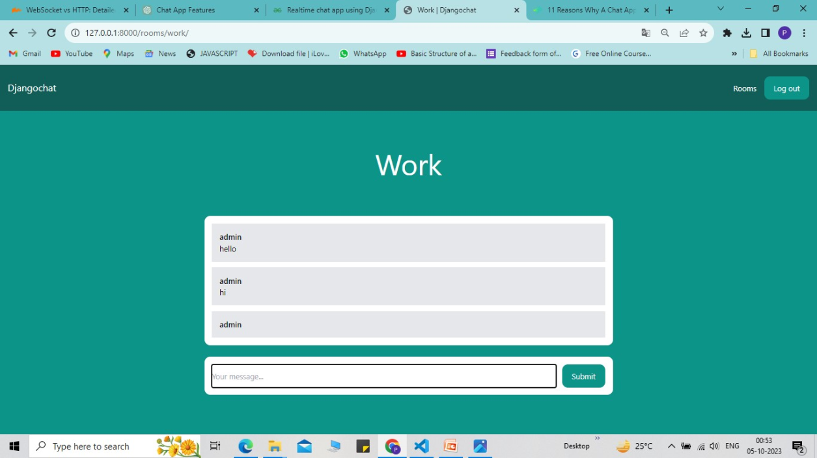
IMAGES

Slide 6
BENEFITS OF CHAT APPLICATION:-
Offer real time communication.
24*7 interactions with customers.
Saves time and money.
Privacy
Easy to Setup
Less TroubleSome

Slide 7
THANK YOU

